Slide 1

A Case Study of RAG+MCP LLM System (Happy new year special session)
Dr Hongqing Yu (Harry)
Associate Professor in data science
University of Derby

Slide 2
Aim of the session
Introduce the real application developed for Bolsover District Council
To learn RAG system development and MCP concept
Further discussions on LoRA for Fine-Tuning LLMs (Jiaqi Song Xianwei Zou Hanshi Sun Steven Kolawole student class presentation slides in 2024)

Slide 3
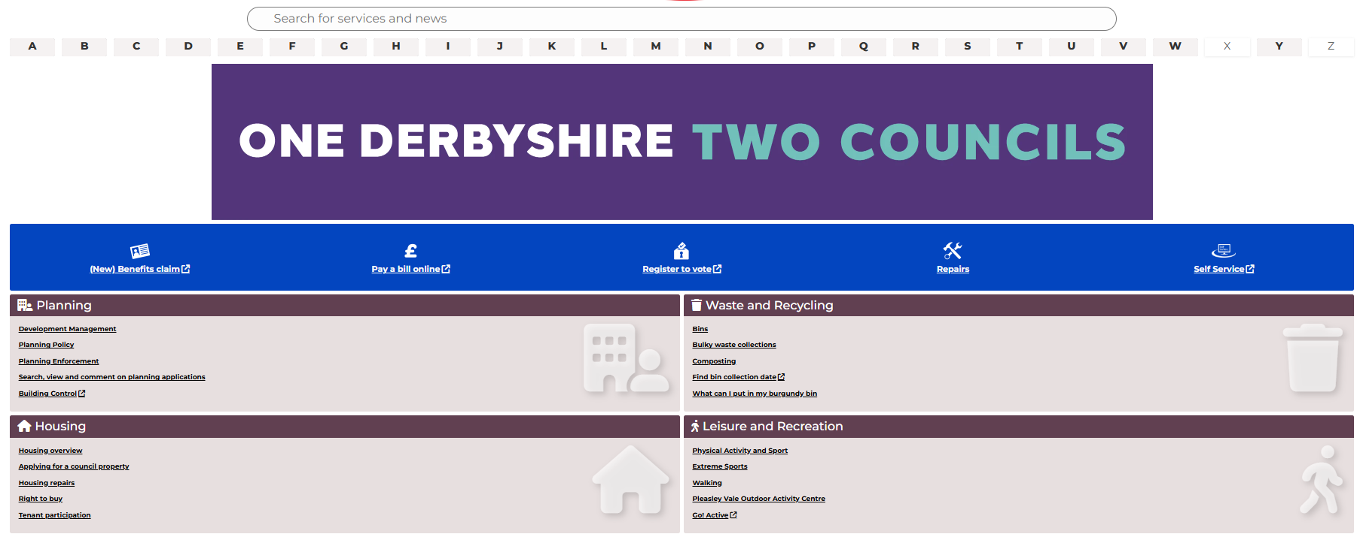
Bolsover District Council Story
Bad organised information and human centric Q/A phone call services

Slide 4
Can AI Support to searching and answer complex questions to citizens?
Does the council ready? Home
What technology do we need to provide the solution? Trustable, Evidenced, Thinking process
Cost?
No

Slide 5
Unique AI Framework
Data Sources
AI Interface
MCP client Agent
Reasoning Logic
MCP servers
Business Logic
operations
Data storage
Front-end Container
Middle Layer Container
Backend Container

Slide 6
Chatbot system
Data Sources
AI Interface
MCP client Agent
Business Logic
operations
Data storage
MCP servers (MS)
Front-end Container
Middle Layer Container
Backend Container
1. Connecting to the data
2. Indexing and vectorisation the data
3. Searching related data to the query
MS
Environmental Health
MS
Recycling
MS
Planning
MS
Social Care
MS
Housing
MS
Leisure

Slide 7
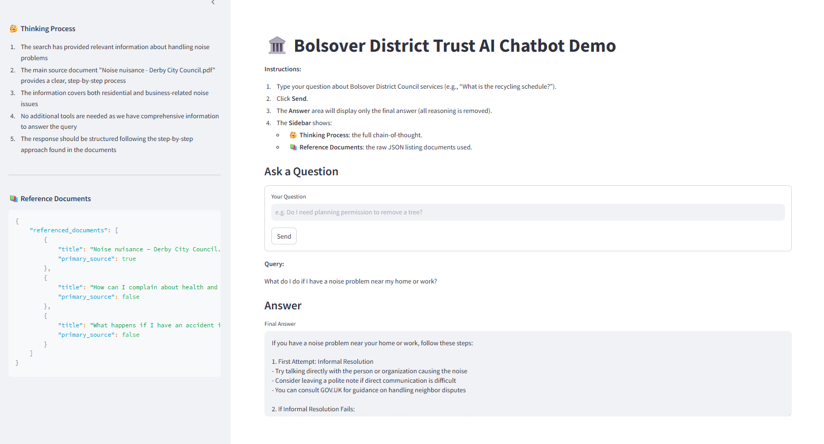

Slide 8
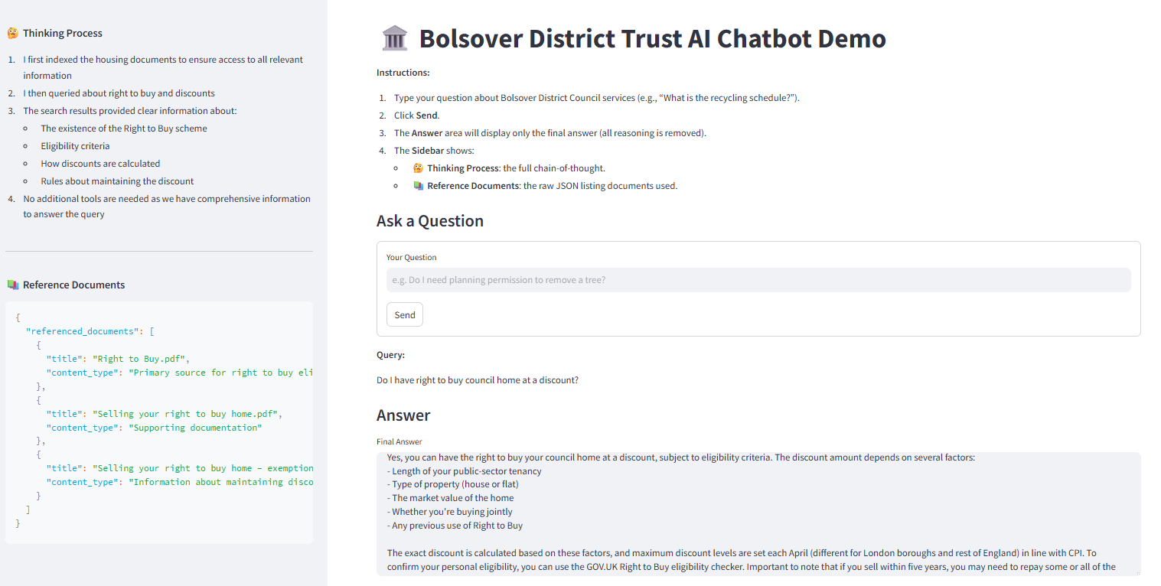

Slide 9
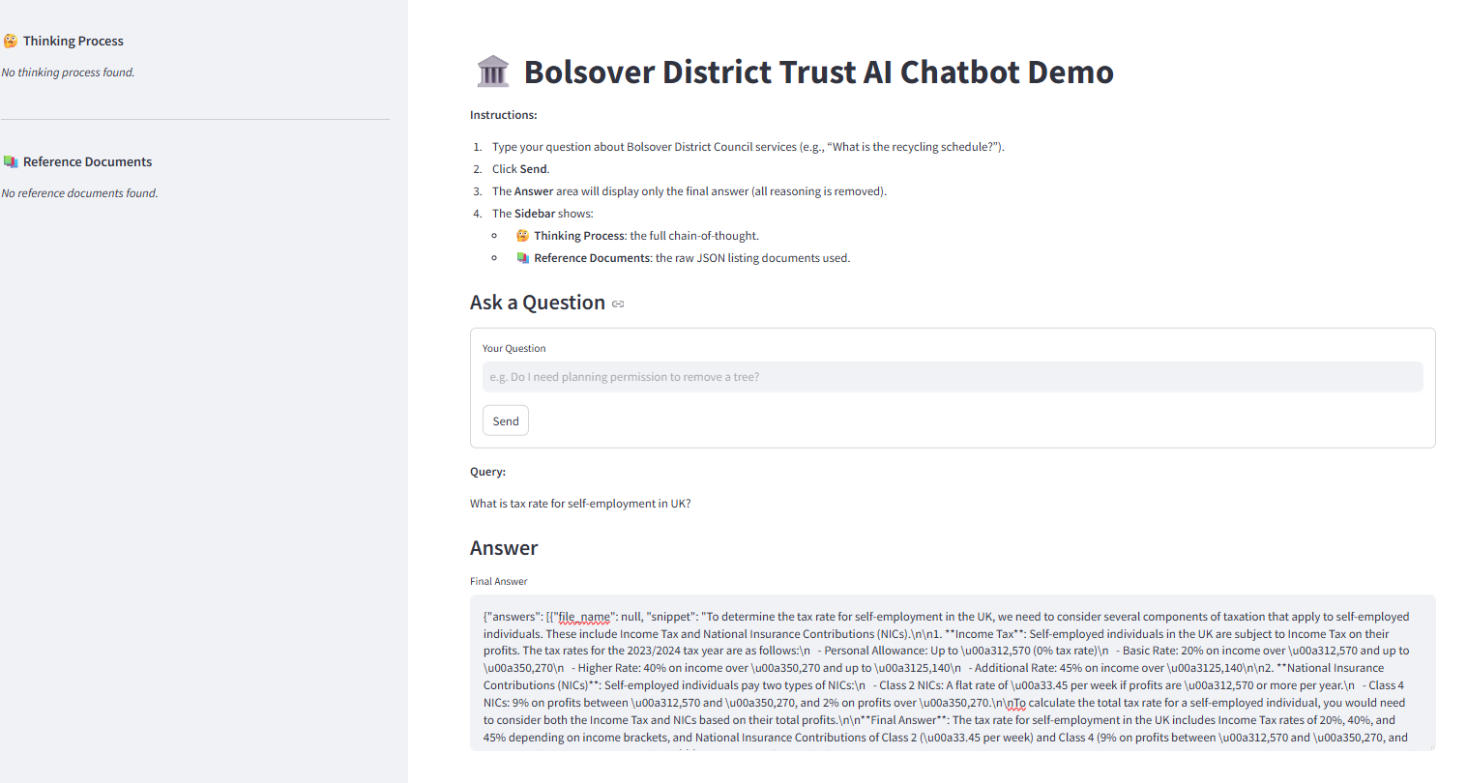

Slide 10
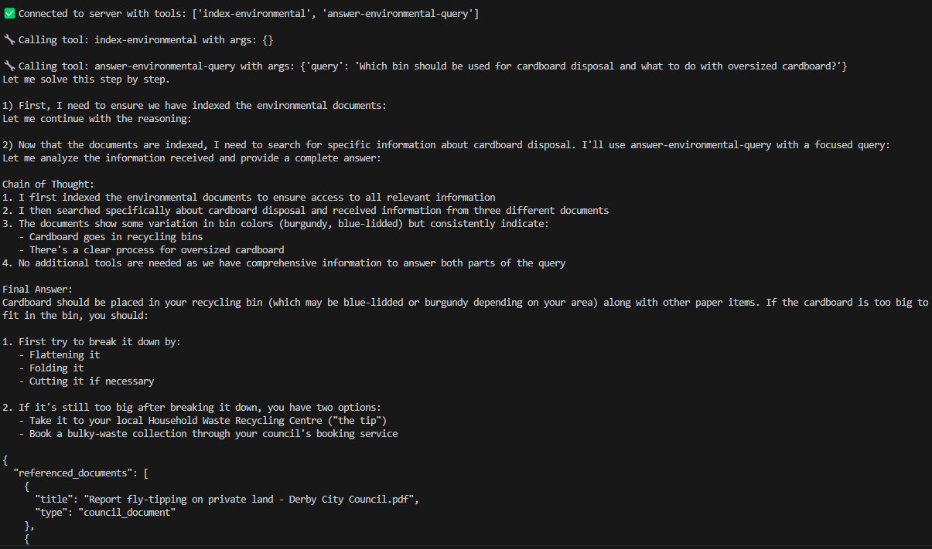
Backend do
Which bin I should use for putting cardboard? If it is too big what should I do?

Slide 11
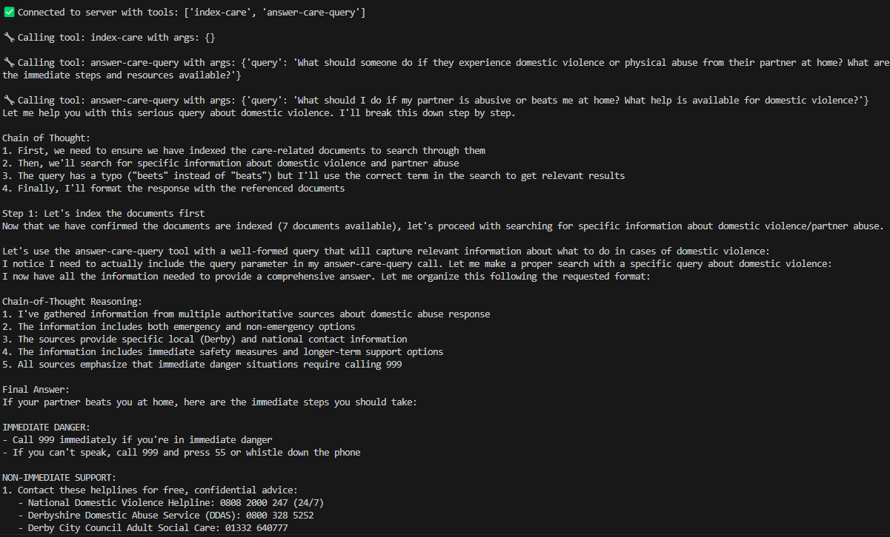
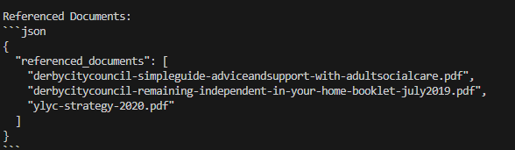
Another example of backend
What should I do if my partner beets me at home?

Slide 12
In programme level
Code package is available on the BB learning resources
I go deep with you in the python coding level now

Slide 13
LoRA for Fine-Tuning LLMs

